Slide 1
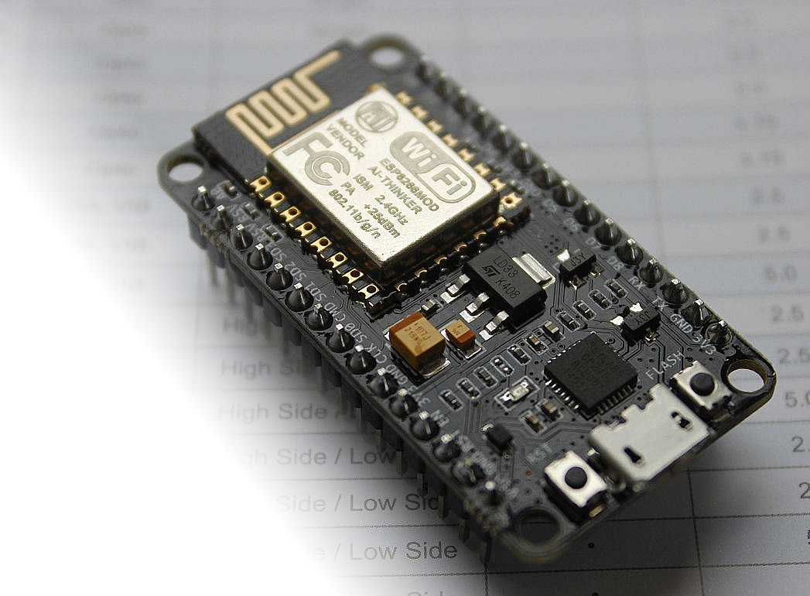
NodeMCU Development Board

Slide 2
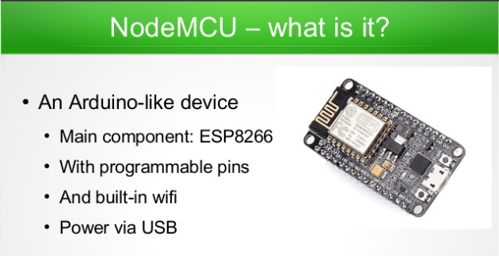

Slide 3
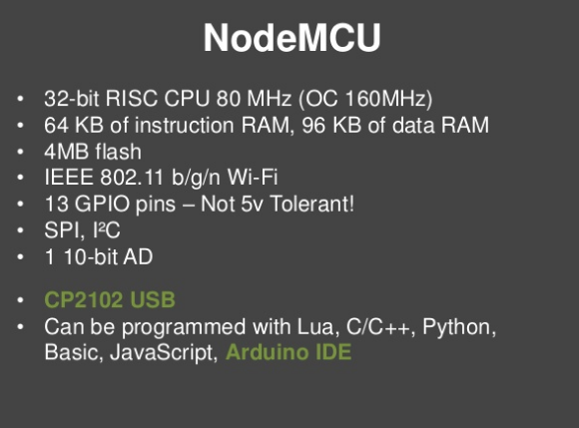

Slide 4
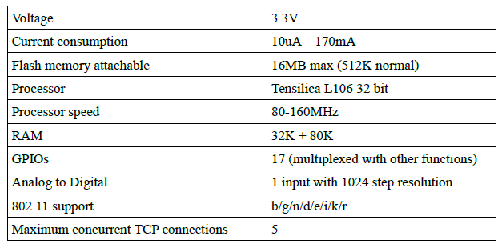
Node MCU - Specifications

Slide 5
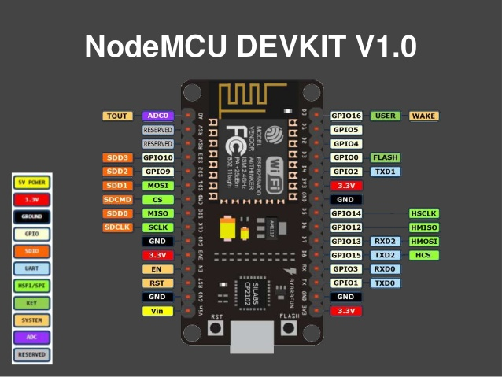

Slide 6
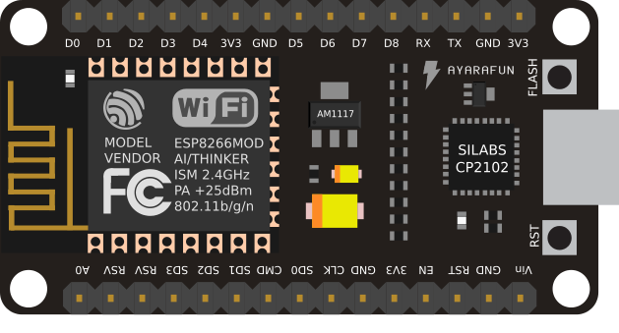

Slide 7

ACTIVITY -1 : SMART WEATHER MONITORING SYSTEM
NODE-MCU
MICRO-CONTROLLER
SENSOR (DHT-11)
WiFi-MODULE
WiFi-ROUTER
4MB FLASH
(WEBPAGE)
THINGSPEAK CLOUD
CLIENT APPLICATION
MOBILE/WEB

Slide 8
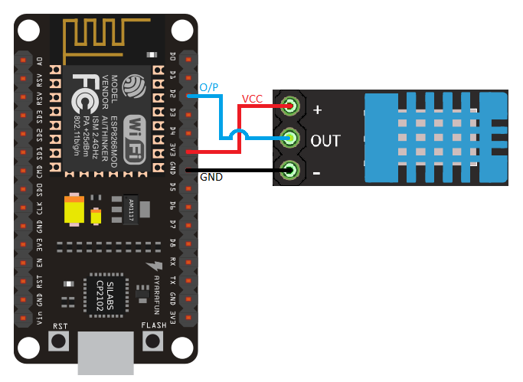
ACTIVITY -1 : SMART WEATHER MONITORING SYSTEM

Slide 9
ACTIVITY -2 : SMART NOTIFIER USING NODEMCU
NODE-MCU
MICRO-CONTROLLER
SENSOR (DHT-11)
WiFi-MODULE
WiFi-ROUTER
4MB FLASH
(WEBPAGE)
IFTTT SERVER
EVENT + TRIGGER
CLIENT APPLICATION
MOBILE/WEB

Slide 10
ACTIVITY -2 : SMART NOTIFIER USING NODEMCU

Slide 11
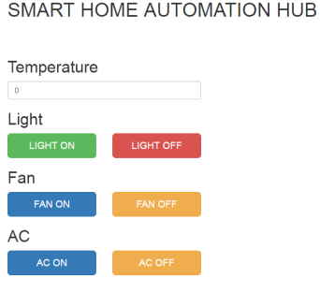
ACTIVITY -2 : SMARTHOME AUTOMATION USING NODEMCU
NODE-MCU
MICRO-CONTROLLER
CONTROLLED APPLIANCES
WiFi-MODULE
WiFi-ROUTER
4MB FLASH
(WEBPAGE)
CLIENT APPLICATION

Slide 12
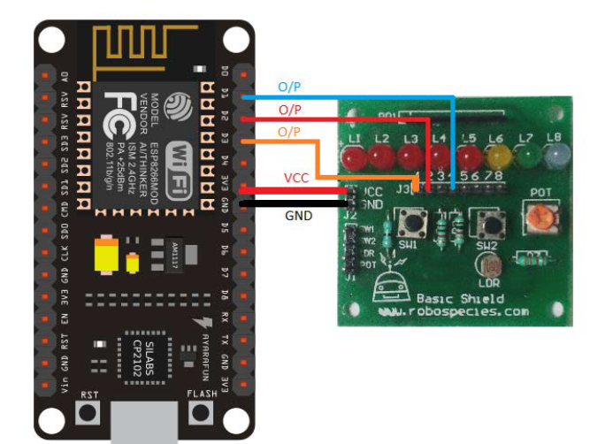
ACTIVITY -2 : SMARTHOME – WEBSERVER USING NODEMCU

Slide 13


